Slide 1

Competitive Programming From Problem 2 Solution in O(1)
P
T
H
I
N
K
F
A
S
T
S
Educational Management System - 2
Mostafa Saad Ibrahim
PhD Student @ Simon Fraser University

Slide 2
Simplification Technique
Whenever you face something that you can’t handle...feel lost...not sure how to start…
This means your mind is not adult enough to handle that...but handle something simpler!
Simply, start to simplify the problem/project as much as needed till you feel I know how to solve this simplified thing => do/solve it
Then, start to add what you removed and make things more complex => do/solve it

Slide 3
Simplification Technique
Imagine we give you a document of 50 pages describing the target educational system!
Some people, based on experience, can have the full picture in mind and design system
Others can’t: start to create a simplified level (basic level) with small subset of the requirements...do it first..then add further features / sub-systems.
E.g. See basic level, advanced level, Acadox in project

Slide 4
Programming Paradigm
A programming paradigm is a fundamental style of computer programming, serving as a way of building the structure and elements of computer programs
A programming language may support one or more paradigm
C++ allows some paradigms such as Procedural programming or Object Oriented programming

Slide 5
Procedural Programming
Procedure = Subroutine = Function
We want do something (e.g. sqrt of function), do step-by-step function that solves that.
Our data (e.g. array of employees) is stored usually using struct (with no methods)...and functions process them
Kind of mess when projects are large scale...anyone access data..can change it..etc

Slide 6
Object Oriented Programming
Data and their related methods are coupled in one location...a class...instance of it is object
1 joined concept instead of 2 separate concepts
So it is all about thinking in your application in terms of objects and how they interact together
+ some more advanced things (Abstraction, Encapsulation, Inheritance, Polymorphism, ...etc)

Slide 7
A hybrid approach
We can implement the project as procedural...but real life is not that now
We also did not study OOP features
I will show a middle solution...we will use structs with methods inside it
We will identify objects: Attributes / Methods
We will create managers...flow controllers for objects
This will learn you the core idea of OOP...thinking in application in terms of objects
As your first real app...it will be little hard :)

Slide 8
Identifying the Objects
Read project description...identify all nouns...see if any of these nouns is composed of attributes….and need operations
Findings: Student, Doctor, Teaching Assistant, Assignment, Solution, Grade, Course
Seems promising objects
In reality, we can think in many, but final design has subset of them..experience helps

Slide 9
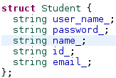




Identifying the Attributes

Slide 10
Identifying the relationships
Doctor
Can teach many courses
Student
Can register in many courses
Can submit many solutions (1 per assignment)
Course
Can be registered by many students
Can be taught by 1 course
Assignment
Belong to 1 course
Can have many submitted solutions (1 per student)

Slide 11
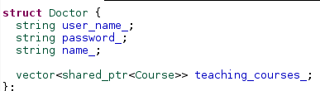
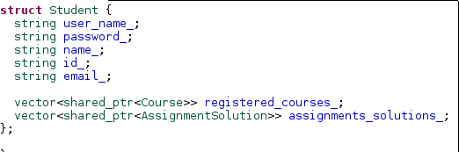
Code the relationships

Slide 12
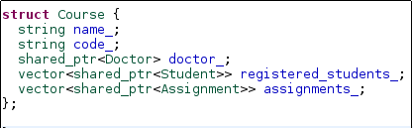
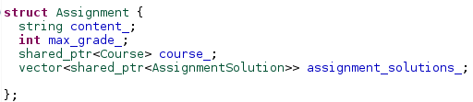

Code the relationships

Slide 13
Misc concerns

Slide 14
Circular relationships
Course need attribute of student...but student too need attribute of course! Compiler fails
Code that...see what is the compiler error message
One way to solve that...to declare the struct … and later define it….this generally better from #include...as it saves compiling time
This is know as forward declaration
You can have methods of declared variables
Or pointer attributes of declared variables

Slide 15
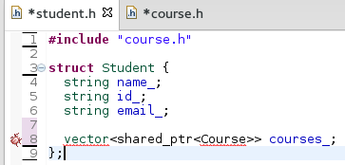
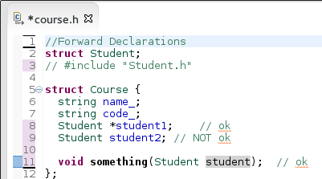

Forward Declaration

Slide 16
Dummy Data Generation
Usually, real system has much data inside it
Instead of run the program, and keep add (e.g. students...courses)...
Add dummy data...for each class add dummy data...
You need to maintain the relationships correct (integrity)...e.g. if student X has course Y...then course Y has student X in its vector
See project description data / running

Slide 17
Extern Global Variables
Sometimes, we need a global variable to be visible through all the project files
To do so, we use keyword extern
Define it as extern in header…
Implement it ONCE in .cpp

Slide 18
Writing Style
As advised before, stick to a writing style, such as Google one
For eclipse, You can download google XML file
Or find it by yourself by searching web “eclipse cpp google style filetype:xml ”
There are many details. Start with naming convention...and from time to time learn more
Some people are against google writing guidelines
Link 1, Link 2
Ctrl + Shift + F in eclipse format code according to the current formatter
Please learn more eclipse shortcuts

Slide 19
Writing Style
Every formatter has limit on line (e.g. 80 chars). Personally, I change it to 160
Edit Google XML file (line 7). Change 80 to your preferred one (e.g. 160)

Slide 20
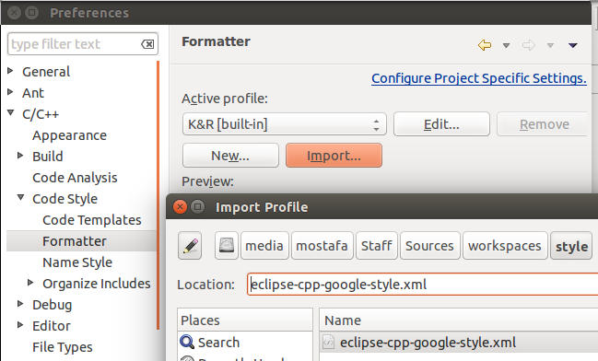
Writing Style
Window => Preferences => Follow screen

Slide 21
Homework
For every struct, think what are the methods we may need to use it
Read/Practice Forward Declaration / Extern
Add methd of GenerateDummyData() for the structs...build dummy data (e.g. list of students..etc)...and maintain correct relationships
Try to complete the system development

Slide 22
تم بحمد الله
علمكم الله ما ينفعكم
ونفعكم بما تعلمتم
وزادكم علماً

